Slide 1
Provider Directories to meet CMS Compliance Requirements
Challenges and Solutions for Medicare and Medicaid Health Plans by Jay Ter Louw, PMP
ProviderDirectorySystems.com jayterlouw@gmail.com

Slide 2
New Federal Requirements CFR 438.10
A QHP (Qualified Health Plan/ Medicare, Medicaid, Health Exchange) issuer must publish an up-to-date, accurate, and complete provider directory, including information on which providers are accepting new patients, the provider’s location, contact information, specialty, medical group, and any institutional affiliations
updated at least monthly
publicly available on their websites in a machine-readable file and format specified by HHS
All written materials for potential enrollees must include taglines in the prevalent non-English languages
Large Print available (font size no smaller than 18 point)
(Regular version) Use a font size no smaller than 12 point.
Data Elements
The provider's name as well as any group affiliation.
Street address(es).
Telephone number(s).
Web site URL, as appropriate.
Specialty, as appropriate.
Whether the provider will accept new enrollees.
The provider's cultural and linguistic capabilities, including languages (including American Sign Language) offered by the provider or a skilled medical interpreter at the provider's office,
and whether the provider has completed cultural competence training.
Whether the provider's office/facility has accommodations for people with physical disabilities, including offices, exam room(s) and equipment.

Slide 3
Many States have additional Requirements Florida Medicaid 2018-2023 Contract Requirements
Data Elements:
Name, Group Affiliation, Street Address, Phone
Web URL (New)
Specialty credentials/certifications
Whether accepting new enrollees
Cultural and Linguistic capabilities
Languages spoken
American Sign Language
Cultural Competence Training
Accommodations for disabilities
Performance indicators
By County
Alpha Order with specialty
Specialty, alphabetically
Updated at least monthly

Slide 4
Three Challenges
Underlying accuracy of the data, gathering all the elements. Hours, phone numbers, accepting new patients, addresses, website, languages.
Consistency of the data. Health Plan IT System=Printed Directory=Online Directory=Geo Maps=Submitted Network Reports.
Data formats meet new requirements
Monthly update
Regular print PDF and copies for distribution
Large print version (federal requirement)
Machine-readable version

Slide 5
Data Accuracy
Responsibility of the Health Plan
Gather required data as part of Contracting/Credentialing
Allow providers to update key fields on website.
Require providers to re-certify quarterly or annually.

Slide 6
Data Consistency
Multiple methods of production and discrepancies result in challenges, inaccurate data to providers and members, and possible fines and penalties.
Maintaining data in multiple systems and delays in coordinating systems result in discrepancies, causing compliance violations and financial penalty assessments
All extracts should be produced from a common Provider Directory File, including Printed, Large-Print, Machine-Readable, Online Directory, Geo-Maps, and Network Adequacy submissions to regulators.

Slide 7
Printed Directory Production
Current cost of production unknown.
Capability and cost for Large-print, Machine-readable formats and monthly camera-ready production unknown.
Automated software to standardize and produce the CMS-required formats is becoming available.
If provider data can be extracted in a simple layout, ProviderDirectorySystems.com has a ‘push-button’ service that produces high-quality, camera-ready directories in seconds.

Slide 8
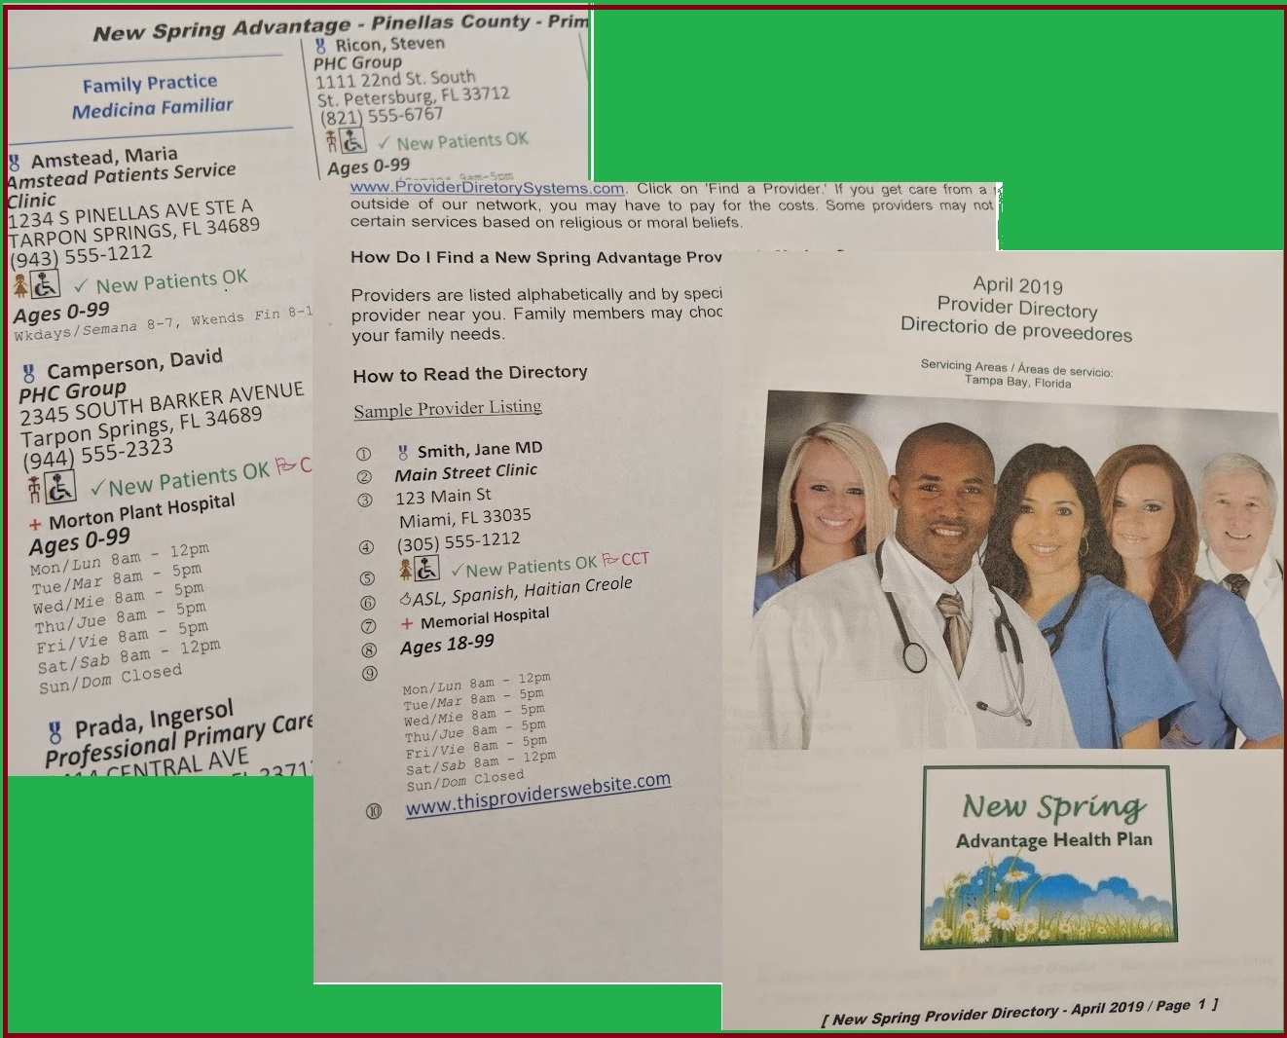

Slide 9
ProviderDirectorySystems.com
Contact for demonstration, pricing and discussion
Jay Ter Louw, PMP
32 years in health care management and consulting for Florida Medicaid, Indiana Medicaid, Florida Department of Health, HIPAA compliance for state agencies and Florida counties (Hillsborough and Broward), and IT Director of Enterprise Architecture for Florida-based Health Plan.
2020 Ox Bottom Rd, Tallahassee, FL 32312
(850) 933-1075
jayterlouw@gmail.com

